Slide 1
Chapter 4
Random Number Generator
Speaker : H.M. Liang

Slide 2
Background
Why random number is necessary?
Seed and distribution
  Random number generator is controlled by seed and distribution
  In NS-2, different table is generated if seed is set to 0

Slide 3
TCL
Create a random number generator
  set rng [new RNG]
Set the random seed
  $rng seed 0 or n , n is an integer
  seed 0 uses current time of day and counter
The name of new generator

Slide 4
TCL
Create an instance of a random variable object with specific distribution
  set rv [new Randomvariable/<type of random-variable>]
Associate a RandomVariable with non-default RNG
  $rv use-rng $rng
Generate a number
  $rv value

Slide 5
TCL - type of random-variable
UniformRandomVariabletools/ranvar.h min_, max_
ExponentialRandomVariabletools/ranvar.h avg_
ParetoRandomVariabletools/ranvar.h avg_, shape_
ParetoIIRandomVariabletools/ranvar.h avg_, shape_
ConstantRandomVariabletools/ranvar.h val_
HyperExponentialRandomVariabletools/ranvar.h avg_, cov_
NormalRandomVariabletools/ranvar.h avg_, std_
LogNormalRandomVariabletools/ranvar.h avg_, std_

Slide 6
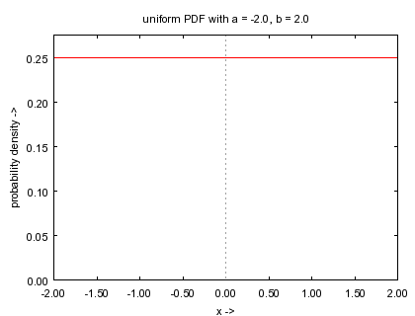
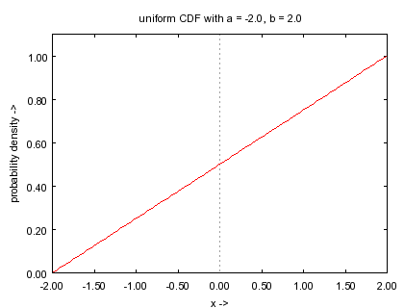
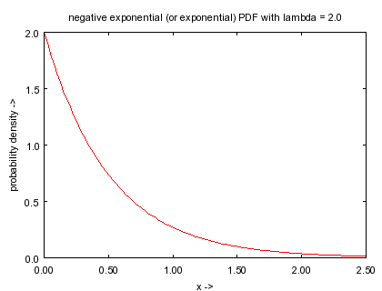
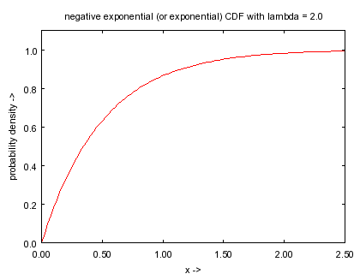
Distribution – Part I

Slide 7
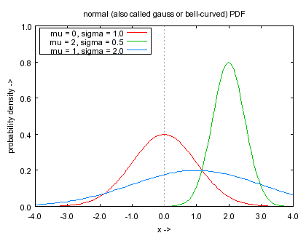
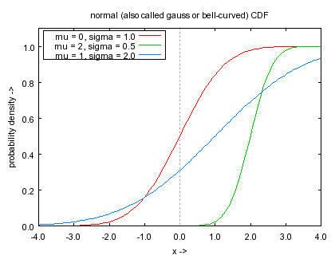
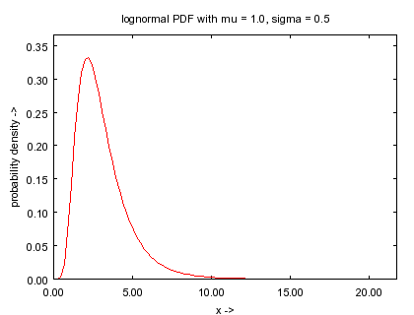
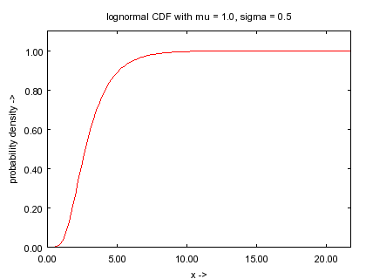
Distribution – Part II

Slide 8
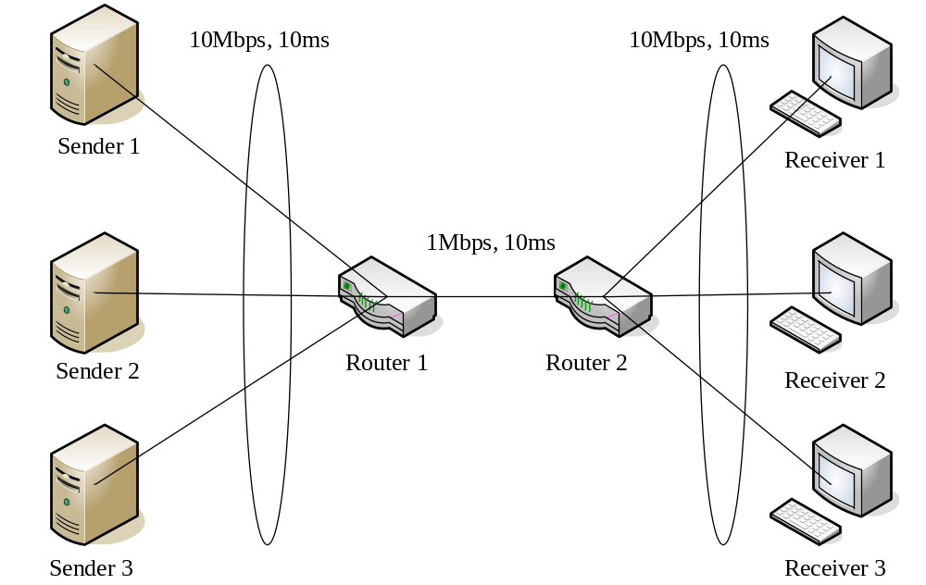
Example

